Slide 1
Module 10
Monitoring, Compliance and Governance in the AWS Cloud

Slide 2
Outline
MODULE 10 INTRODUCTION
  Introduction to Monitoring, Compliance, and Governance in the AWS Cloud
MONITORING AND COMPLIANCE SERVICES
  Introduction to Monitoring
  Amazon CloudWatch
  AWS CloudTrail
  Compliance
  Auditing AWS Resources for Compliance
  AWS Organizations
  Governance
  AWS Health
  AWS Trusted Advisor

Slide 3
Introduction to Monitoring, Compliance, and Governance in the AWS Cloud

Slide 4
In this lesson, you will learn:
Describe the progression of monitoring, governance, and compliance activities.

Slide 5
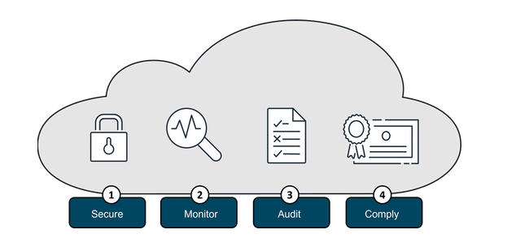
Monitoring your resources in the AWS Cloud
To effectively monitor your Amazon Web Services (AWS) Cloud solutions, you will need ways to provide insights into resource utilization, identify potential issues, and facilitate proactive problem resolution.
The progression you generally want to use is as follows:
  1. Securing systems
  2. Monitoring activities
  3. Conducting audits
  4. Ensuring compliance

Slide 6
Monitoring your resources in the AWS Cloud
Secure
  Protect data, systems, and infrastructure from unauthorized access, use, disclosure, disruption, modification, or destruction
Monitor
  Continuously observe and analyze system activity, network traffic, and security events to detect potential threats or anomalies
Audit
  Periodically review and assess the effectiveness of security controls and check that all requirements are met and security policies and procedures are adhered to
Compliance
  Help ensure that an organization's security practices and controls meet the requirements of relevant regulations, industry standards, and contractual obligations

Slide 7
Introduction to Monitoring

Slide 8
In this lesson, you will learn:
Define monitoring in the cloud.
Describe the benefits of monitoring your AWS Cloud resources.

Slide 9
Importance of monitoring
In the AWS Cloud, monitoring is the continuous process of collecting, visualizing, and tracking the health and performance of your AWS infrastructure, services, and applications.
This goal of monitoring is to help ensure optimal performance and identify potential issues.
It provides a way for you to continuously observe and analyze system activity, network traffic, and security events to detect potential threats or anomalies.

Slide 10
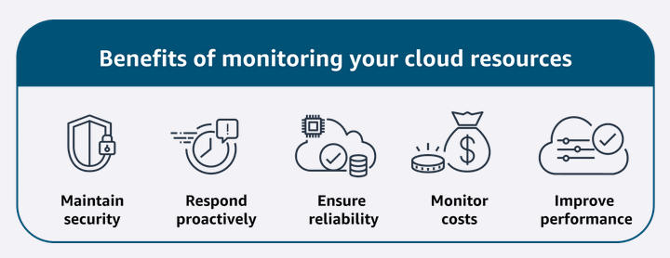
Importance of monitoring
Monitoring and observability are critical components for ensuring the security, availability, reliability, and performance of your cloud-based workloads and data.
Monitoring is performed using real-time monitoring tools, log collection and analysis, and dashboards.
In the following lessons, you will identify several different monitoring tools and what they do.

Slide 11
Amazon CloudWatch

Slide 12
In this lesson, you will learn:
Describe benefits and use cases of Amazon CloudWatch.

Slide 13
Watch over your resources and applications
Amazon CloudWatch
  CloudWatch monitors your AWS resources and the applications that you run on AWS in real time.
  With CloudWatch, you gain system-wide visibility into resource utilization, application performance, and operational health.
  CloudWatch does more than just monitor. It has several features that work together:
    CloudWatch metrics
    CloudWatch alarms
    CloudWatch dashboards
    CloudWatch logs

Slide 14
Amazon CloudWatch Features
Metrics
  CloudWatch collects metrics from all your AWS resources, applications, and services that run on AWS and on-premises servers.
Alarms
  With CloudWatch alarms, you can define thresholds on CloudWatch metrics and send notifications or automatically make changes to the resources.
Dashboards
  Dashboards are customizable home pages in the CloudWatch console that you can use to monitor your resources in a single view.
Logs
  CloudWatch Logs centralize the logs from all of the systems, applications, and AWS services that you use.

Slide 15
Amazon CloudWatch
Benefits:
  CloudWatch helps you visualize and analyze your resources, operate efficiently with automation, use an integrated view, proactively monitor, and gain insights.
Use case:
  It can be used to monitor and troubleshoot infrastructure.
Example:
  A retail company is using CloudWatch features to monitor their application running on Amazon Elastic Compute Cloud (Amazon EC2) instances.
  CloudWatch automatically collects metrics, like utilization, on the EC2 instances.
  The company sets up CloudWatch to collect logs on the application performance.
  They also have alarms for when the Amazon EC2 utilization gets too high for an extended period.
  They even have an action configured to automate and scale up the number of EC2 instances when the alarm sounds.
  Finally, they create a custom dashboard to visualize everything all in one place.
  Now they can analyze the logs to gain insights on performance issues or application errors.

Slide 16
AWS CloudTrail

Slide 17
In this lesson, you will learn:
Describe why auditing is important.
Describe benefits and use cases of AWS CloudTrail.
Describe CloudTrail events, logs, and insights.

Slide 18
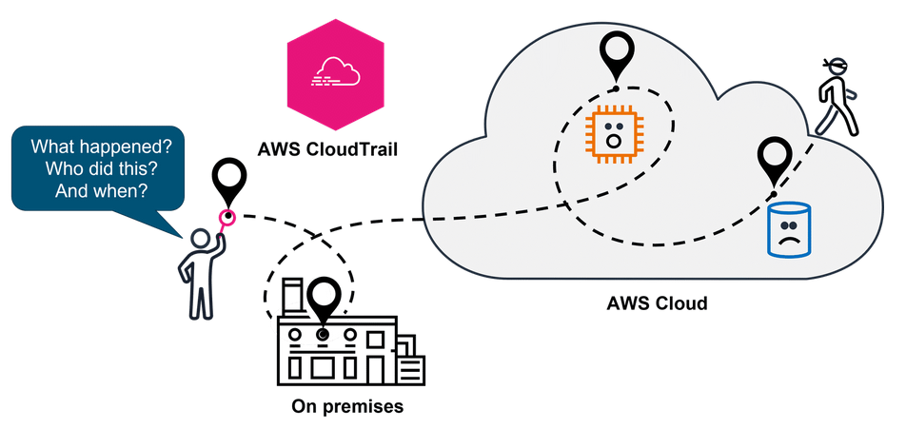
Importance of auditing
Imagine a financial company with a hybrid cloud solution trying to figure out what happened when there are changes made to their resources in the cloud and on premises.
They need this information for troubleshooting and to provide detailed records for compliance. That's where CloudTrail can help.

Slide 19
AWS CloudTrail
CloudTrail tracks user activity and API usage in the AWS Cloud, on premises, and even with other cloud providers.
CloudTrail provides a detailed history of API calls, so you can track changes and identify who made them and when.
This helps you understand what actions were taken on your AWS resources.
Benefits: CloudTrail provides auditing, security monitoring, and operational troubleshooting. It also helps you prove compliance and improve your security posture.
Use cases: It can be used for compliance and auditing, identifying security incidents, troubleshooting operational issues.

Slide 20
CloudTrail features
CloudTrail events
  CloudTrail events capture details about actions performed within your AWS account, such as API calls, console actions, or other activities.
  Event history provides a viewable, searchable, downloadable, and immutable record of the past 90 days of management events in an AWS Region.
  There are no CloudTrail charges for viewing event history.
CloudTrail logs
  CloudTrail monitors events and delivers those events as log files to your Amazon Simple Storage Service (Amazon S3) bucket.
  Because CloudTrail logs are securely stored, they can be used to prove compliance with regulations such as Payment Card Industry (PCI) and Healthcare Insurance Portability and Accountability Act (HIPAA).
CloudTrail insights
  CloudTrail Insights analyzes your normal patterns of API call volume and API error rates.
  CloudTrail Insights also generates Insights events when API call volumes and error rates deviate from these normal patterns.
  You can enable CloudTrail Insights in your trails or event data stores to detect anomalous behavior and unusual activity.

Slide 21
Compliance

Slide 22
In this lesson, you will learn:
Define compliance and the benefits of compliance with AWS.
Describe AWS Artifact, its benefits, and the two types.
Locate resources for AWS compliance.

Slide 23
Benefits of compliance with AWS
Compliance refers to your cloud resources and data adhering to relevant regulations, industry standards, and internal policies regarding security and data protection.
AWS helps you meet compliance goals and requirements in the following ways:
  Inheriting the latest security controls that AWS uses on its own infrastructure
  Third-party validation for thousands of global requirements
  Streamlining and automating compliance
  On-demand compliance reports

Slide 24
AWS Artifact
AWS Artifact is a service that provides no-cost, on-demand access to AWS security and compliance reports and select online agreements.
Benefits: AWS Artifact helps you manage at scale, save time with on-demand access to compliance reports, and deploy with more confidence.
Use cases: It can be used to manage select online agreements and assess third-party security and compliance.

Slide 25
AWS Artifact two types
AWS Artifact Agreements
  Suppose that your company needs to sign an agreement with AWS regarding your use of certain types of information throughout AWS services.
  You can do this through AWS Artifact Agreements.
  In AWS Artifact Agreements, you can review, accept, and manage agreements for an individual account and for all your accounts in AWS Organizations.
  Different types of agreements are offered to address the needs of customers who are subject to specific regulations, such as the Health Insurance Portability and Accountability Act (HIPAA).

Slide 26
AWS Artifact two types
AWS Artifact Reportrs
  Next, suppose that a member of your company’s development team is building an application and needs more information about their responsibility for complying with certain regulatory standards.
  You can advise them to access this information in AWS Artifact Reports.
  AWS Artifact Reports provide compliance reports from third-party auditors.
  These auditors have tested and verified that AWS is compliant with a variety of global, regional, and industry-specific security standards and regulations.
  AWS Artifact Reports remains up to date with the latest reports released.
  You can provide the AWS audit artifacts to your auditors or regulators as evidence of AWS security controls.

Slide 27
AWS Compliance
The AWS Compliance portal contains resources to help you learn more about AWS compliance. You can read customer compliance stories to discover how companies in regulated industries have solved various compliance, governance, and audit challenges.
You can also access compliance whitepapers and documentation on topics such as the following:
  AWS answers to key compliance questions
  An overview of AWS risk and compliance
  An auditing security checklist
For essentials and best practices, guides, and workbooks, including training, visit Additional compliance resources.

Slide 28
Auditing AWS Resources for Compliance

Slide 29
In this lesson, you will learn:
Describe the benefits and use cases of AWS Config.
Describe the benefits and use cases of AWS Audit Manager.

Slide 30
Inro
In the previous lesson, you learned about compliance with AWS and the industry compliance programs.
In this lesson, you will explore several AWS services that you can use to help ensure that your resources comply with your company's standards or requirements.
Most companies will want you to follow specific configuration guidelines for your different AWS resources.
This means that you will want a way to assess and audit the resources that you create on AWS to help ensure that they meet those rules.
That's where AWS Config can help.

Slide 31
AWS Config service
AWS Config is a service that you can use to assess, audit, and evaluate the configurations of your AWS resources.
Benefits: AWS Config helps evaluate configurations against a desired state, manage resource configuration changes, and simplify troubleshooting and remediation.
Use cases: It can be used to continually audit security monitoring and analysis and to streamline operational troubleshooting and change management.

Slide 32
AWS Audit Manager service
Audit Manager is a service that continually audits your AWS usage to simplify risk and compliance assessment.
It helps collect evidence and manage audit data.
Benefits: Audit Manager saves time with automated evidence collection, streamlines collaboration across teams, and helps ensure integrity of audits with read-only permissions.
Use case: It can be used to automate evidence collection, continually audit to assess compliance, and deploy internal risk assessments.

Slide 33
AWS Organizations

Slide 34
In this lesson, you will learn:
Define the benefits and use cases of AWS Organizations.
Describe key concepts of how AWS Organizations works.

Slide 35
AWS Organizations
Organizations helps you centrally manage and govern your environment as you grow and scale your AWS resources.
It helps you manage policies for groups of accounts and automate account creation.
Benefits: Organizations provides several benefits like quickly scaling your environment by programmatically creating new AWS accounts for resources and teams. It also helps by simplifying permission management through SCPs and managing and optimizing costs across your AWS accounts and resources.
Use cases: It can be used for automating AWS account creation, providing tools and access for your security teams, controlling user access to designated services, and sharing common resources across accounts.

Slide 36
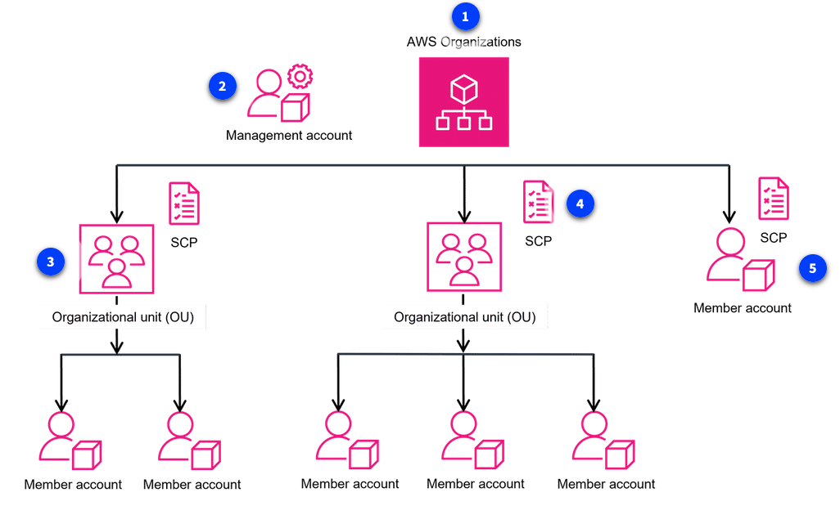
Key concepts of Organizations
An organization is a collection of AWS accounts that you can manage centrally and organize into a hierarchical, tree-like structure with a root at the top and organizational units (OUs) nested under the root.
Each account can be located directly in the root or placed in one of the OUs in the hierarchy.

Slide 37
Key concepts of Organizations
AWS Organizations
  AWS Organizations is used to consolidate and manage multiple AWS accounts within a central location.
  When you create an organization, it automatically creates a root, which is the parent container for all the accounts in your organization.
Management account
  The management account is the central AWS account that creates and manages the organization. It's responsible for overall control and governance.
Organizational unit (OU)
  An organizational unit (OU) is a logical grouping of accounts in an AWS Organization. OUs can contain member accounts or nested OUs.

Slide 38
Key concepts of Organizations
Service control policies (SCP)
  An SCP is a policy that lets you place restrictions on the AWS services, resources, and individual API actions that users and roles in each account can access. SCPs can be applied to either OUs or individual member accounts.
Member account not in an OU
  If you have a member account that has unique requirements that do not overlap with those of an organizational unit, you can add them to the organization. They do not have to be placed under an OU. This account can still take advantage of benefits such as consolidated billing.

Slide 39
Key concepts of Organizations
In designing your organization, you should consider the business, security, and regulatory needs of each department.
You use this information to decide which departments group together in OUs.
To learn more about centrally managing your environment as you scale your AWS resources, refer to the AWS Organizations User Guide.

Slide 40
Governance

Slide 41
In this lesson, you will learn:
Describe the benefits and use cases AWS Control Tower.
Describe the benefits and use cases of AWS Service Catalog.
Describe the benefits and use cases of AWS License Manager.

